Slide 1
Mini capstone project
Crime Analysis

Slide 2
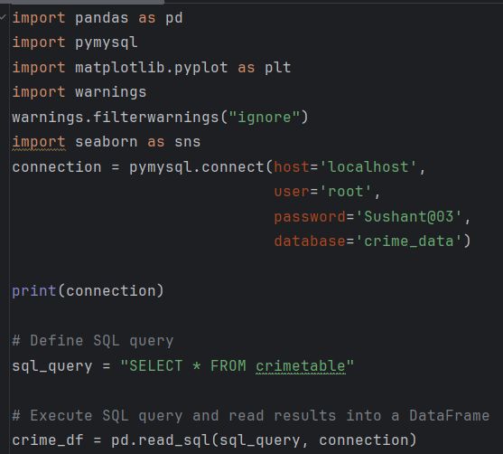
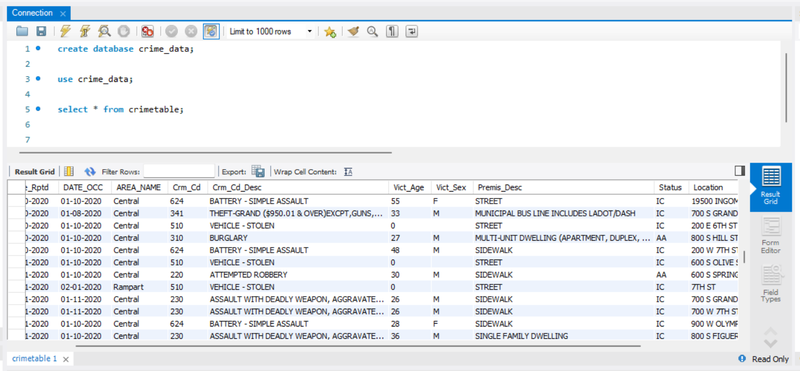
Creating a database and connecting to PyCharm IDE

Slide 3
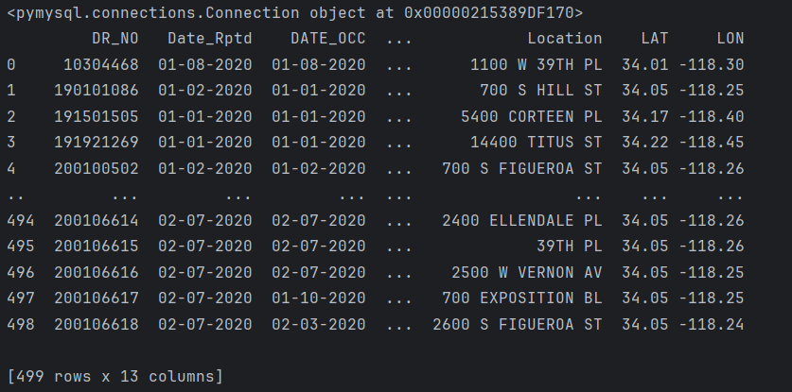

Full dataset in PyCharm after connection

Slide 4
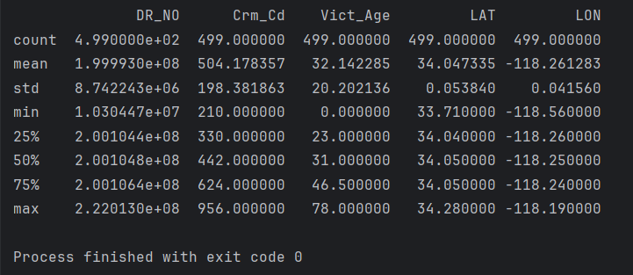
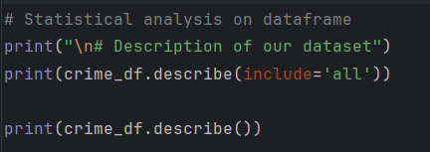
Statistical Analysis

Slide 5
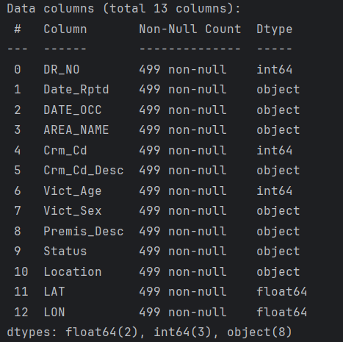

Information about the dataset

Slide 6
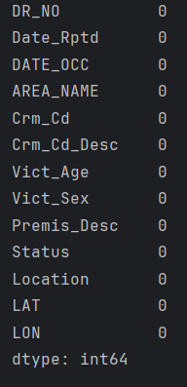

Null values if any

Slide 7


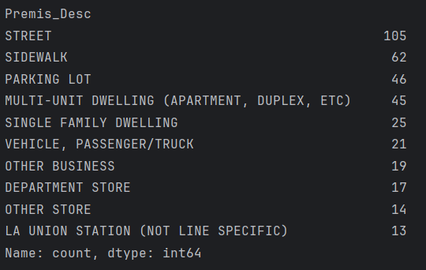

Common area names
Top 10 Premise description

Slide 8
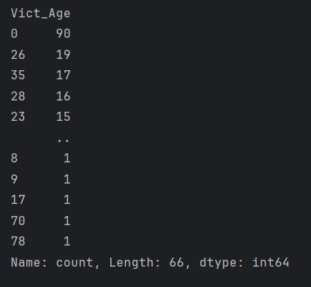

Top victim ages

Slide 9
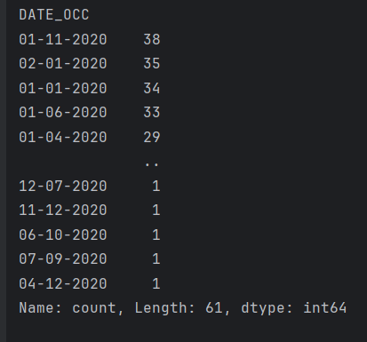

Maximum crime based on date

Slide 10
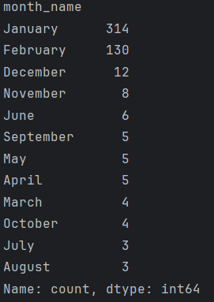

Maximum crime based on month

Slide 11
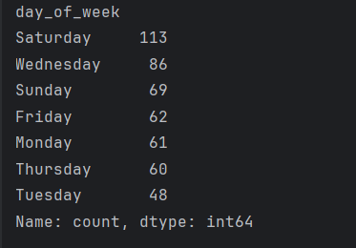

Maximum crime based on day of week

Slide 12
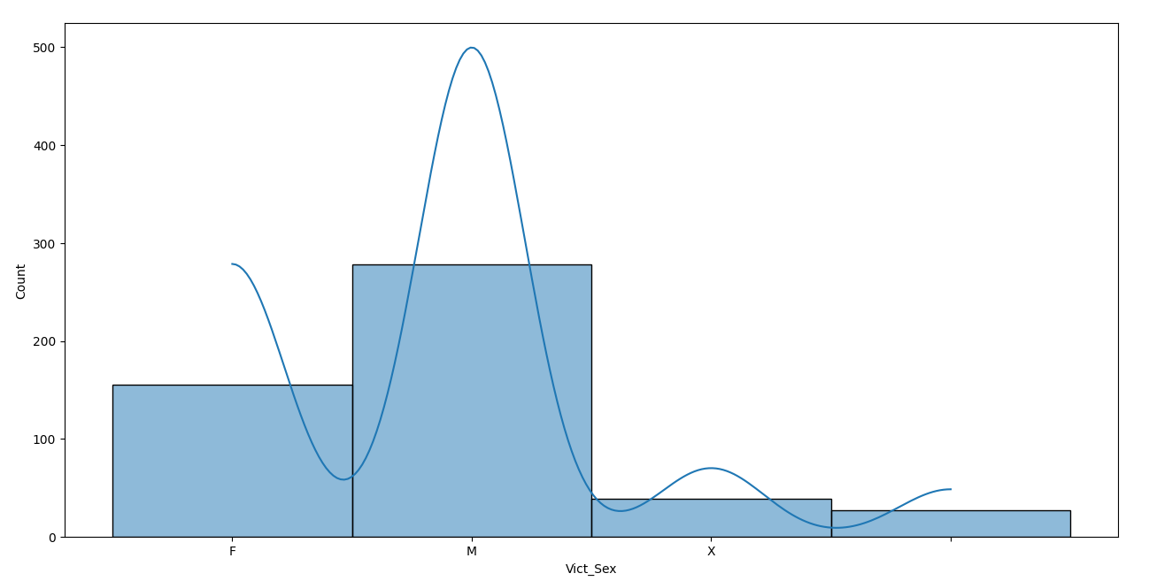

Victim sex analysis

Slide 13
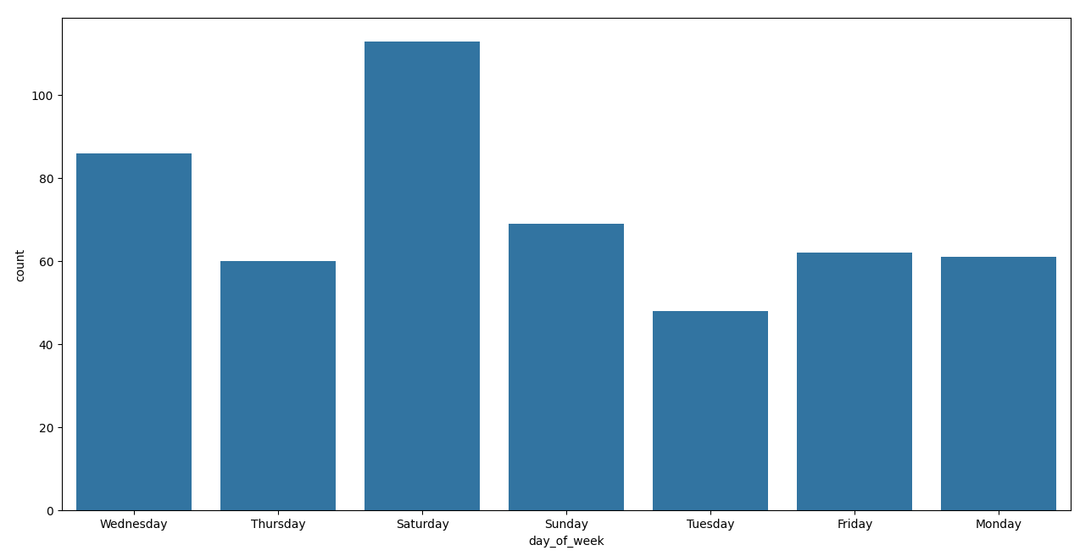
Week days crime analysis

Slide 14
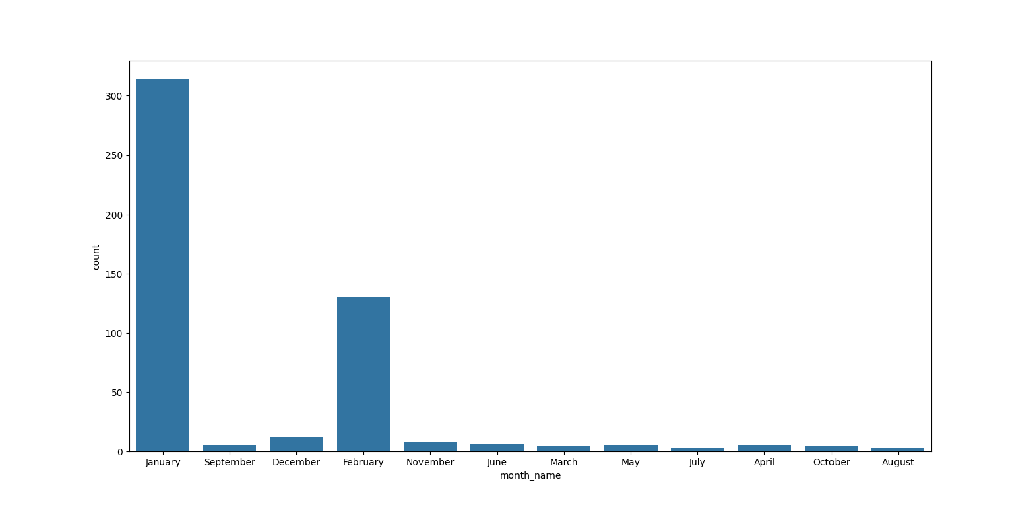
Monthly crime analysis

Slide 15
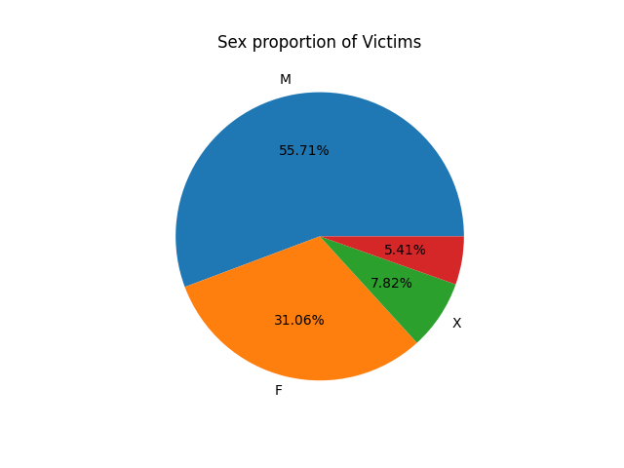
Victim sex crime analysis

Slide 16
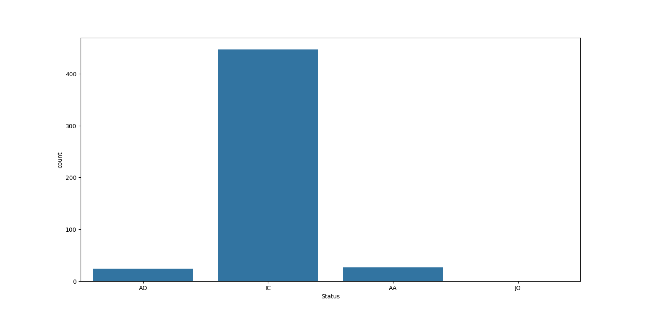
Status analysis

Slide 17
Thank you.

